Slide 1
Chemistry VR
Members: Elizabeth Dayton, Cole Beck, Byeonghyeon Choi, Jay Cieutat, Ben Dempsey, Nick Arnold, Joshua Gatlin, and Everett Clemons

Slide 2
Introduction
Our purpose was to introduce the redox titration lab to a student before they complete the lab in person
This is to reduce lab waste and increase learning
This would be done through an interactive VR simulation of a lab

Slide 3
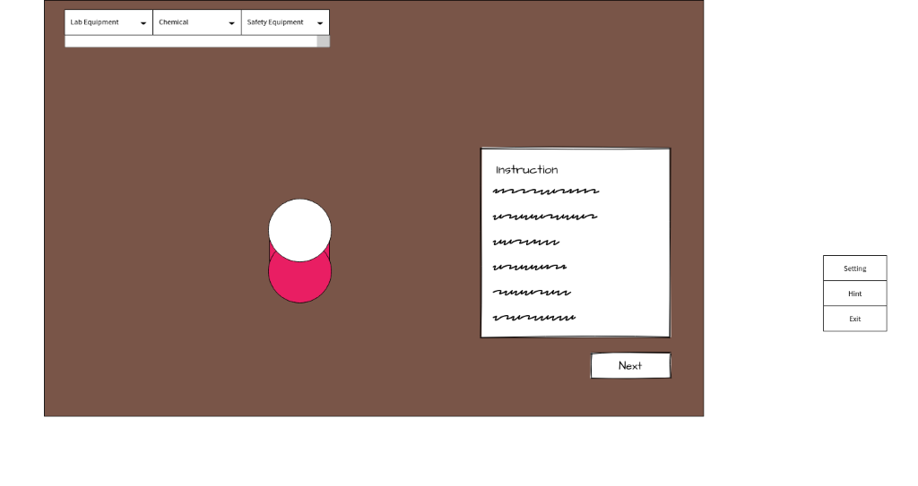
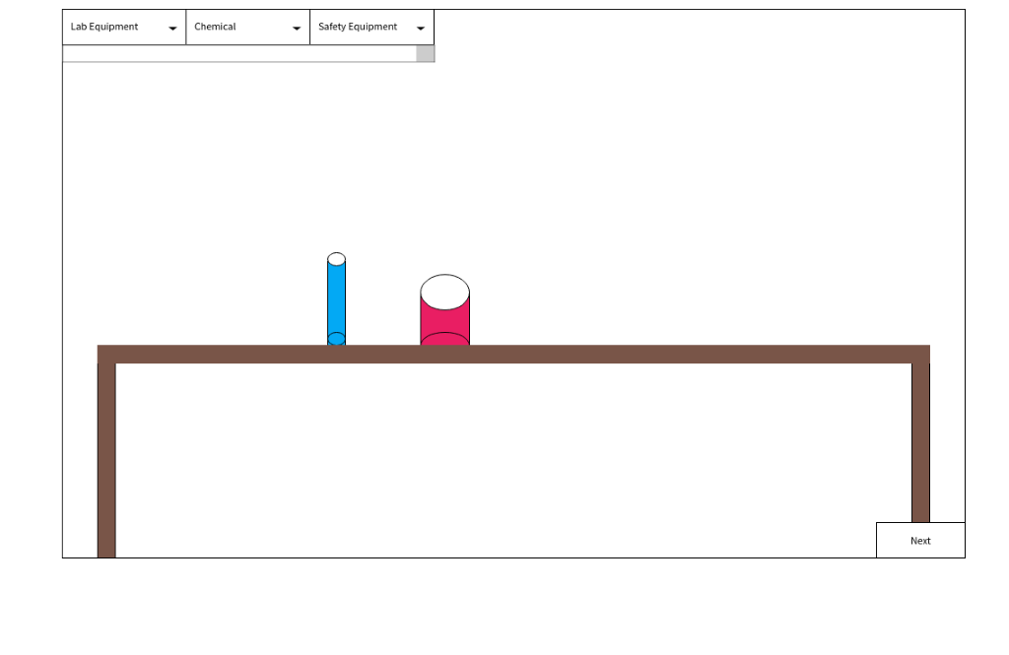
Wireframes

Slide 4
Conceptual Model
The functional requirements we have for our application to be successful are as follows:
The system shall support a student so that they will feel comfortable with the redox titration experiment and are familiar with how to complete each of the steps.
The system shall support a student using the Chemistry VR application in learning the redox titration experiment so that they may complete it with little to no errors in a real-world lab.
The system shall support a student in that if they are struggling to understand or complete any of the steps, they will be met with helpful hints and suggestions until they can complete the step.

Slide 5
A Few Interesting Benefits of VR
VR helps with learning retention in all groups of people through combining visual, audio, and a 3D environment
VR can be used to simulate foreign countries for the purpose of learning the language
VR can also be used to simulate building structures for the purpose of learning architecture

Slide 6
Implementation Details
Created planes to act as the floor and walls since objects would fall through them.
Added rigid bodies to objects, made furniture kinematic. The furniture had been jumpy before this.
Created a character and added code to allow it to move.
Tied the camera to the character and added code to look around.
Tied a kinematic pointer to the camera.
Added code to make it possible to pick up and move objects.
Added code to make the pointer turn green when pointing at an object that can be picked up.

Slide 7
A Short Project Demonstration

Slide 8
Analysis and Conclusions
Unity is complex and has a steep learning curve
VR applications are also very complex and developing them requires having the hardware on hand
Most of our time was spent doing Unity tutorials (Roll-a-ball game)

Slide 9
Future Work
Add steps for the actual redox titration lab
Add helpful hints while the user completes the lab
Add a notebook where any calculations done during the lab can be recorded
Overall touching up of the lab space

